Slide 1
Lexical Analyzer

Slide 2
Outline
Conversion of Regular Expression to Transition diagram
Lex Tool

Slide 3
Typical Tokens in a PL
Symbols: +, -, *, /, =, <, >, ->, …
Keywords: if, while, struct, float, int, …
Integer and Real (floating point) literals
123, 123.45
Char (string) literals
Identifiers
Comments
White space

Slide 4
Recognition of Tokens: Transition Diagram
Ex :RELOP = < | <= | = | <> | > | >=
2
=
return(relop,LE)
1
3
return(relop,NE)
>
<
start
other
#
0
=
5
4
return(relop,LT)
return(relop,EQ)
>
6
=
7
return(relop,GE)
other
#
# indicates input retraction
8
return(relop,GT)

Slide 5
Recognition of Identifiers
Ex2: ID = letter(letter | digit) *
Transition Diagram:
letter or digit
#
start
letter
other
9
10
11
return(id)
# indicates input retraction

Slide 6
Mapping transition diagrams into C code
letter or digit
start
letter
other
9
10
11
return(id)
switch (state) {
case 9:
if (isletter( c) ) state = 10; else state = failure();
break;
case 10: c = nextchar();
if (isletter( c) || isdigit( c) ) state = 10; else state 11
case 11: retract(1); insert(id); return;

Slide 7
Lexical analyzer loop
Token nexttoken() {
while (1) {
switch (state) {
case 0: c = nextchar();
if (c is white space) state = 0;
else if (c == ‘<‘) state = 1;
else if (c == ‘=‘) state = 5;
…
case 9: c = nextchar();
if (isletter( c) ) state = 10; else state =fail();
break;
case 10: ….
case 11: retract(1); insert(id);
return;

Slide 8
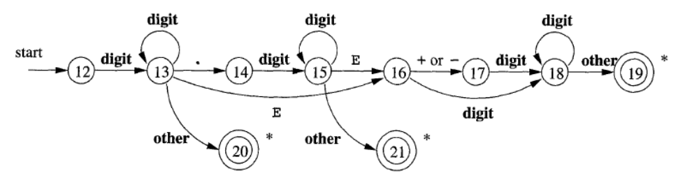
The transition diagram for token number
Multiple accepting state
Accepting integer
e.g. 12
Accepting float
e.g. 12.31
Accepting float
e.g. 12.31E4

Slide 9
Lex – Lexical Analyzer Generator
Lex
specification
Lex
C/C++/Java
compiler
flex – more modern
version of lex
jflex – java version of
flex
input
exec
tokens

